Slide 1

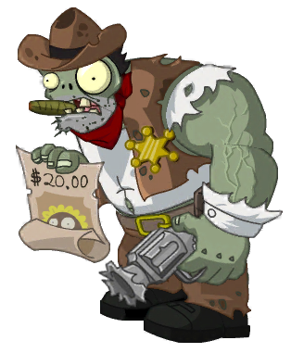
Zombie Apocalypse

Slide 2
Objects
- Player
- Zombie
- Weapons
- Map
- Scoreboard

Slide 3
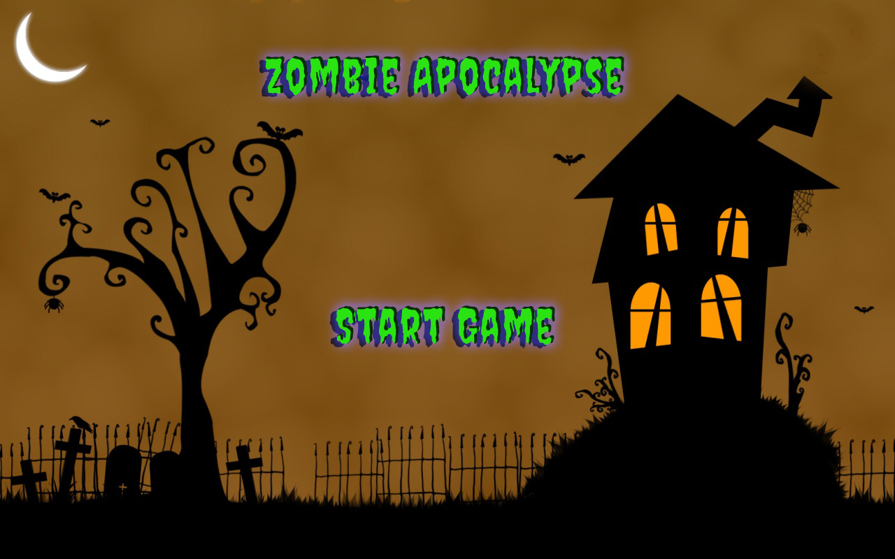

Slide 4
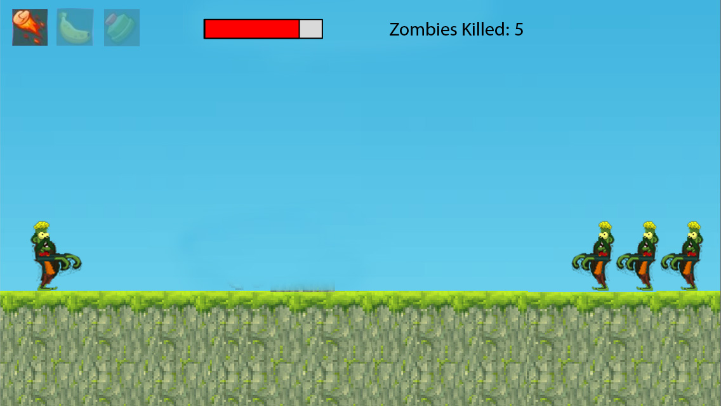

Slide 5
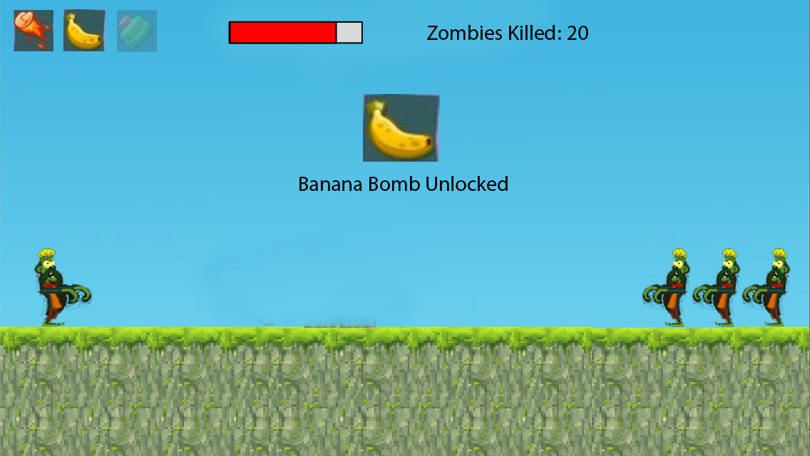

Slide 6
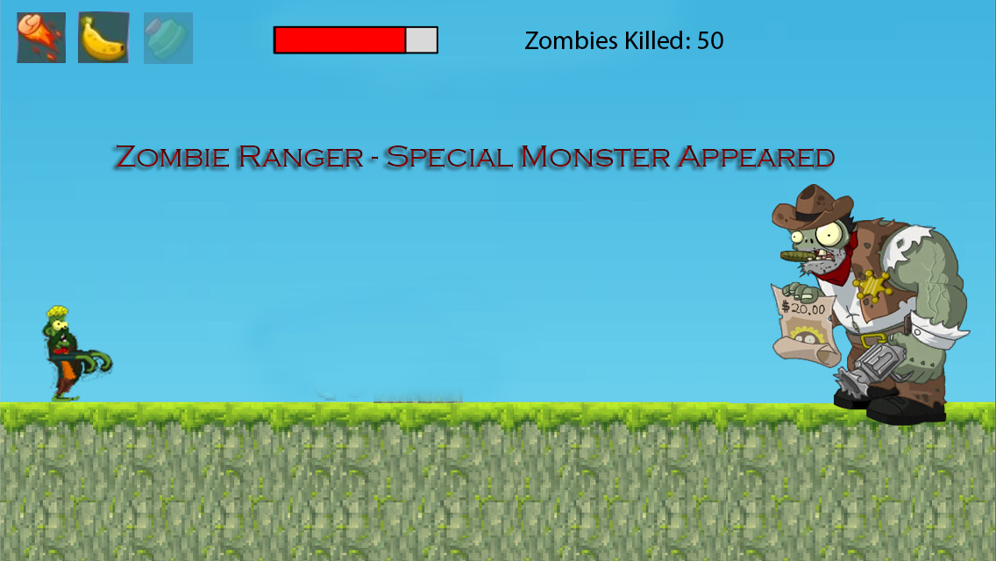

Slide 7
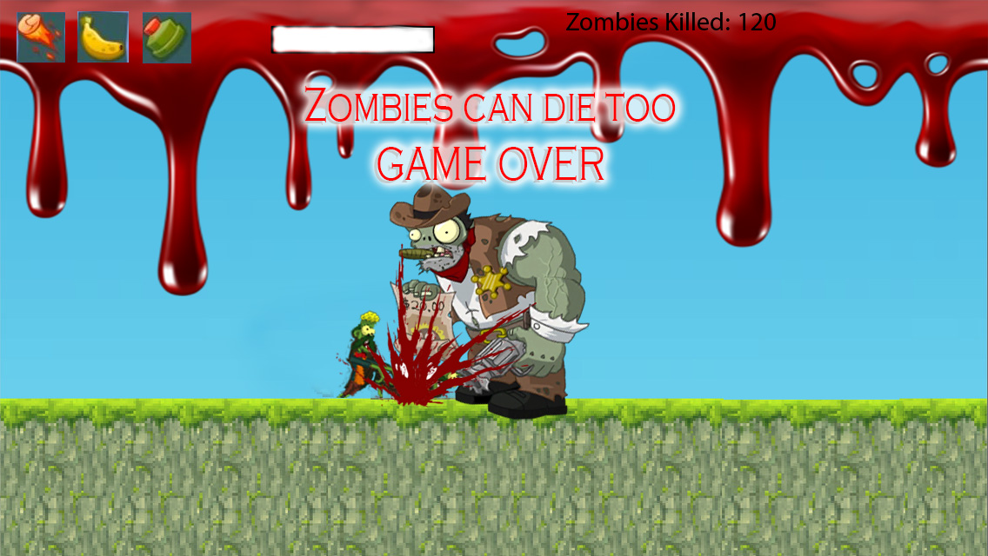

Slide 8
